Slide 1



6 Minute Mobile Apps with NativeScript
A Race Against Time

Slide 2


Slide 3
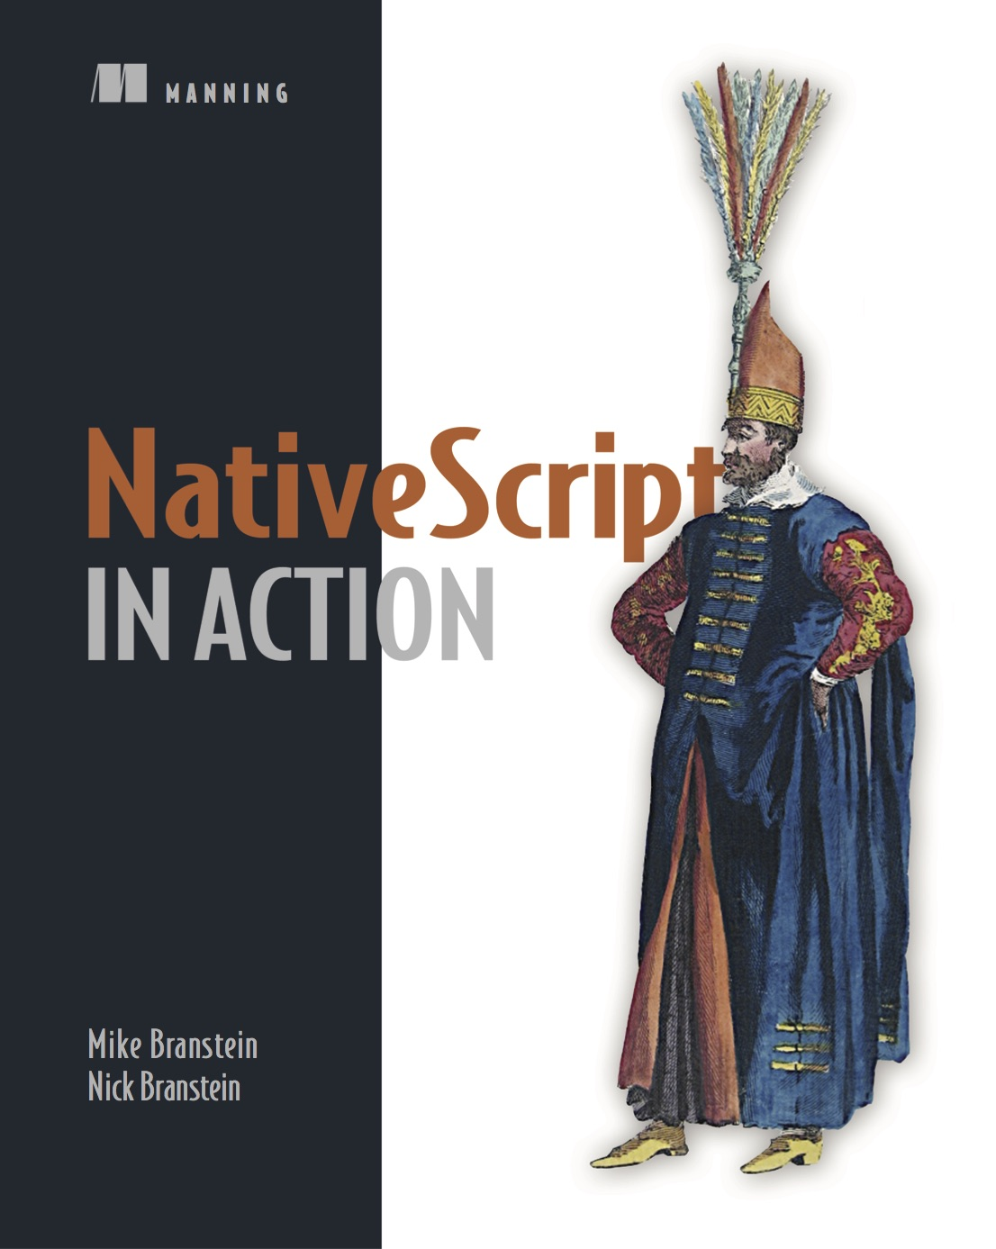
Mike Branstein
@mikebranstein
https://brosteins.com
@brosteins
http://bit.ly/nsinaction
40% off: ctwmcctw
http://kizan.com

Slide 4
Created and supported by Telerik
Notes:
I mention this because, in today’s world, where 10 JavaScript frameworks have been created since I started this presentation, that it’s important to pick an innovative and stable options

Slide 5
Delivering on the promise of “hybrid.”
Notes:
OK, what I want you to come away with today is that there are options. A lot of options for mobile development. Native, Phone Gap/Cordova, Xamarin. I want you to also be aware of NativeScript.
But let’s talk about hybrid mobile development first. What is the promise of hybrid app development?

Slide 6
Hybrid Promise
100% Web
Hybrid
100% Native
Reach
Code/Skill Reuse
Richness
Premium experience
Device APIs
Best of both?
Notes:
It’s not really write once, run everywhere. It’s a blend of code/skill reuse and having some access to device APIs.

Slide 7
NativeScript is…
an open source framework for building truly native mobile apps with JavaScript. Use web skills, like TypeScript, Angular, and CSS, and get native UI and performance on iOS and Android.
Notes:
I want to call out a few things about what NativeScript is an what it is not.
You can build mobile apps with:
JavaScript
Similar to hybrid apps in that you can use Angular 2, CSS, skills to write apps
You get native performance, because you’re running native code
Not in a web view

Slide 8
The {N} difference…
Notes:
How?
Let’s talk about 3 reasons why NativeScript is different.

Slide 9

1
Rich, animated, “no compromise” native UI
(with shared UI code)
Search for
“Examples NativeScript”
in the iOS App Store or Google Play to try this out for yourself.
Notes:
One.
You have access to native UI components on iOS and Android, with native performance, with shared UI code. You write XML, this is directly transposed to native UI elements and rendered.
Head to the Andorid and iOS stored to get a copy of this app and see for yourself – search for “Examples NativeScript”

Slide 10
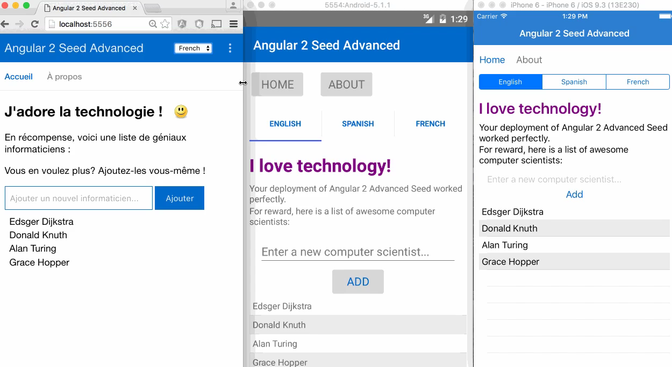
2
Maximum code and skill reusability
Video credit: Nathan Walker, {N} community member
Notes:
Two
Do you currently use npm, CocoaPods, Android Arsenal? You can use that with {N}. Here’s the same app, running in-browser, on Android, and on iOS. Same code, 3 platforms.

Slide 11
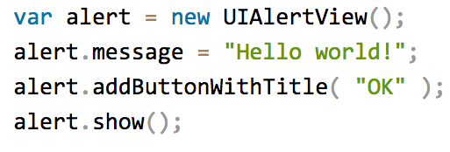
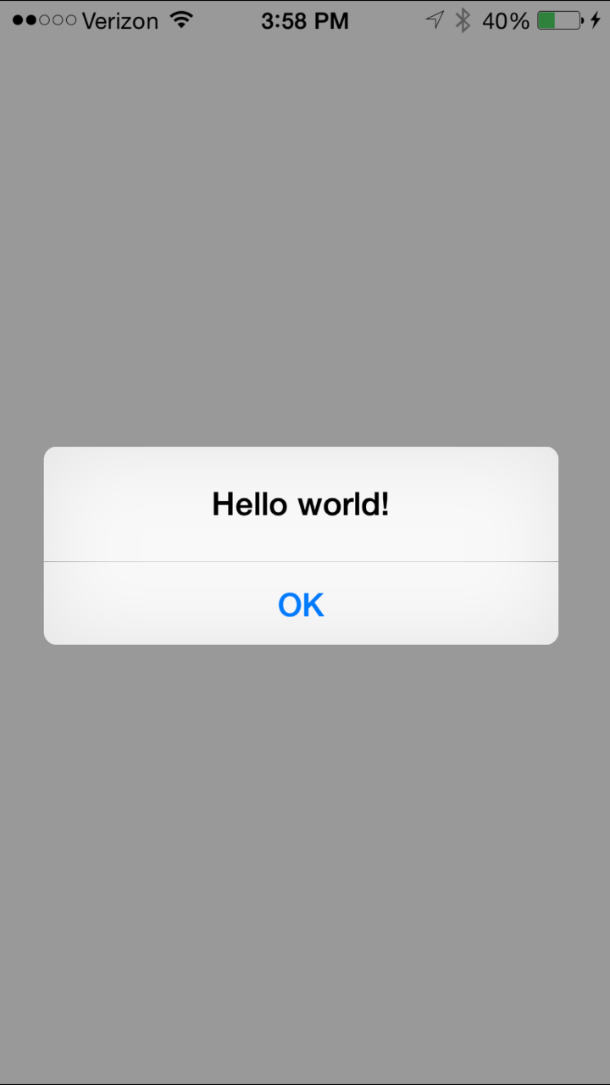
3
100% access to Android and iOS APIs
Notes:
Three dot One
This is where it gets really cool:
this is the iOS API
but it’s not written with Objective-C – it’s really JavaScript using the iOS API

Slide 12
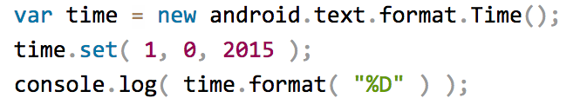


Runs on V8 JavaScript VM
Runs on JavaScriptCore VM
More details at http://bit.ly/how-nativescript-works
Notes:
Three dot Two
Here’s how it works:
You access the native apis directly from JavaScript
Your app runs in a JavaScript VM
V8 on Android, JavaScriptCode on iOS
When the app runs, the VM routes the API calls directly down to the native API, running in real-time

Slide 13
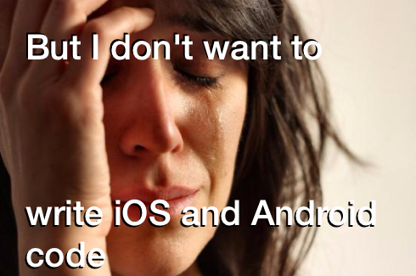
Notes:
That’s ok.

Slide 14
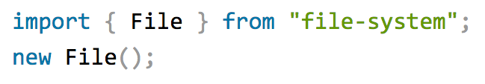



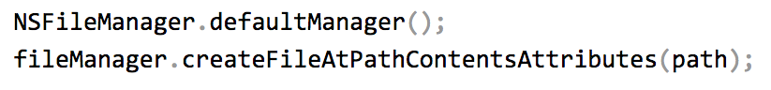
Example: NativeScript file module
Notes:
There is a set of core modules that abstract these things away for you, so you have a unified experience across the platforms,
BUT if you really need to access Objective C and Java directly, that capabilitiy is always there.

Slide 15

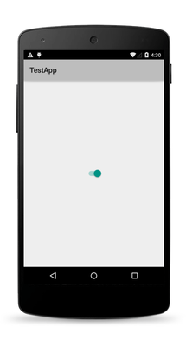
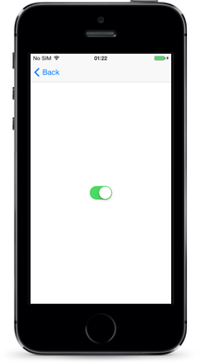
The same approach works for the UI
Notes:
The XML markup you use for a UI is actually instantiates the JavaScript objects, which get mapped back to native API objects.

Slide 16
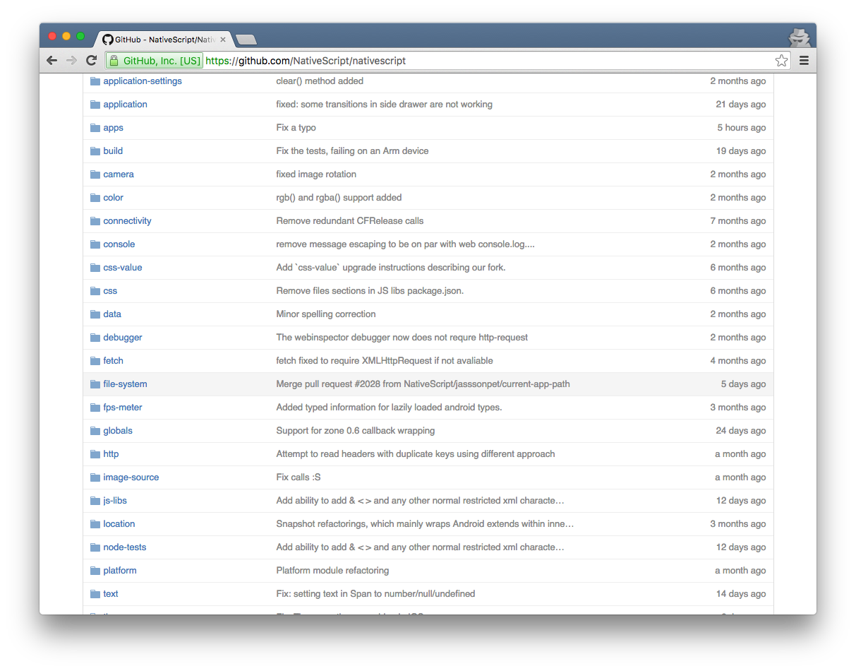
NativeScript Modules—There are a lot

Slide 17
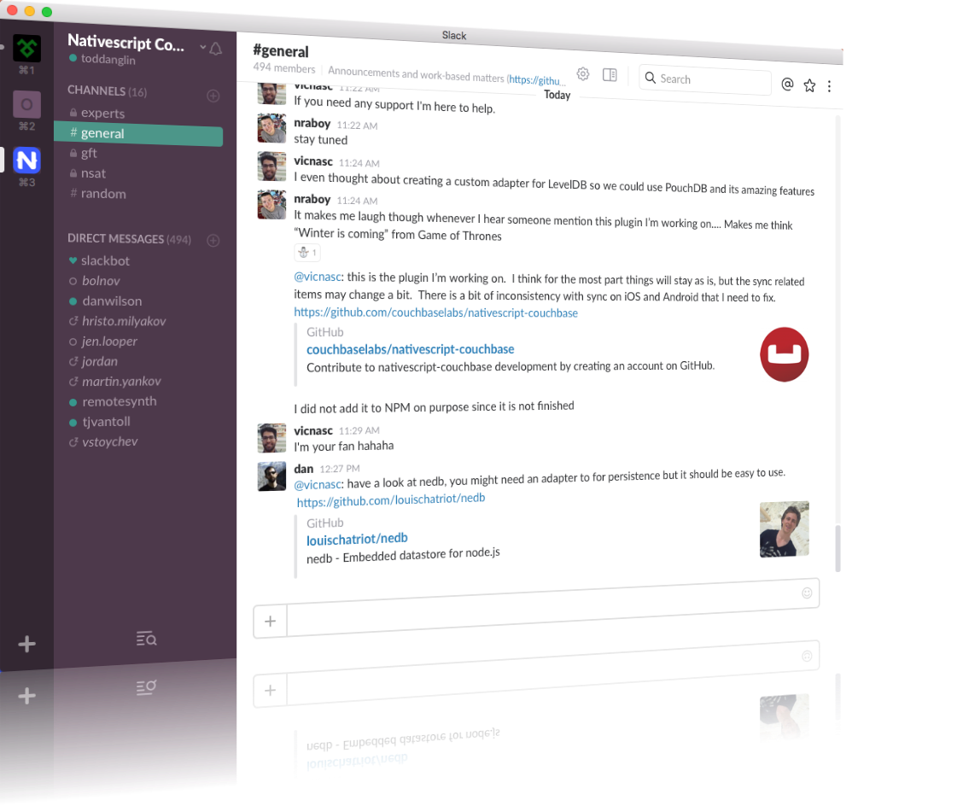
Join the growing NativeScript community on Slack
bit.ly/nativescript-slack

Slide 18
I need your help!
@MikeBranstein
#MakeMeAnApp

Slide 19
Let’s get ready to…

Slide 20

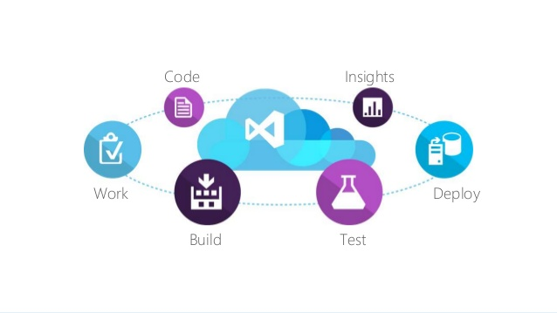




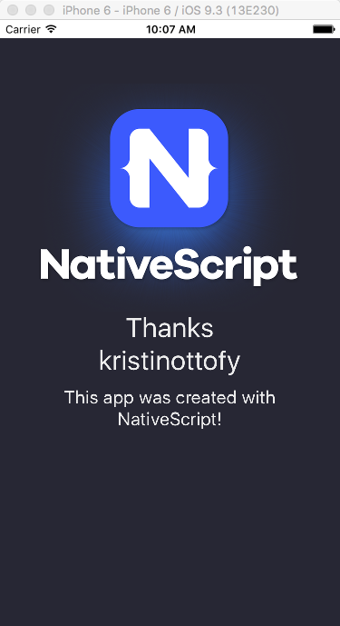
triggers
listener
Azure Logic App
if (tweet-found)
then (trigger-build)
Visual Studio Team Services (VSTS) Build
@MikeBranstein
#MakeMeAnApp
reply tweet
git repo
queues build
tns run ios
{N} App Template
screenshot to Azure REST API endpoint
VSTS Mac Build Agent
VSTS Mac Build Agent

Slide 21
Mike Branstein
@mikebranstein
https://brosteins.com
@brosteins
http://bit.ly/nsinaction
40% off: ctwmcctw
http://kizan.com

